Slide 1





ARTIFICIAL INTELLIGENCE USAGE IN GAME DEVELOPMENT
Article by:
DHANAMMA JAGLI
Subhashchandra Nalla
Srinivasrao Danikonda
Laxmi Nakirekanti
Published Date: 27 June 2024

Slide 2


INTRODUCTION & EVOLUTION OF AI IN GAMING
"Artificial Intelligence has become the heart of modern game development".
Evolution: Early graphics & logic systems, Machine learning & real-time adaptation.
Makes games realistic and engaging through intelligent characters.
Based on research by Jagli, Chandra, Dhanikonda, Nakirekanti (2024).

Slide 3


WHY AI MATTERS IN MODERN GAMES
Smart enemy behavior - creates dynamic challenges
Adaptive difficulty - adjusts to player skill automatically
Realistic environments - immersive worlds that feel alive
Personalized experiences - tailored to individual players
Essential for AR/VR - simulates real-world interactions

Slide 4



KEY AI METHODS & TECHNIQUES
Decision Trees - rule-based logical predictions
Deep Neural Networks - pattern recognition for realism
Genetic Algorithms - automatically evolves strategies
Reinforcement Learning - learns through trial and error

Slide 5



ROLE OF AI IN MODERN GAME DESIGN
AI is no longer just an add-on; it defines how games think, react, and evolve.
Traditional games followed fixed rules, but now AI lets games learn from players and adapt in real time.
This shift marks a movement from programmed logic to dynamic intelligence, making gaming more unpredictable and engaging.
Developers analyze player data to make smarter in-game reactions.

Slide 6
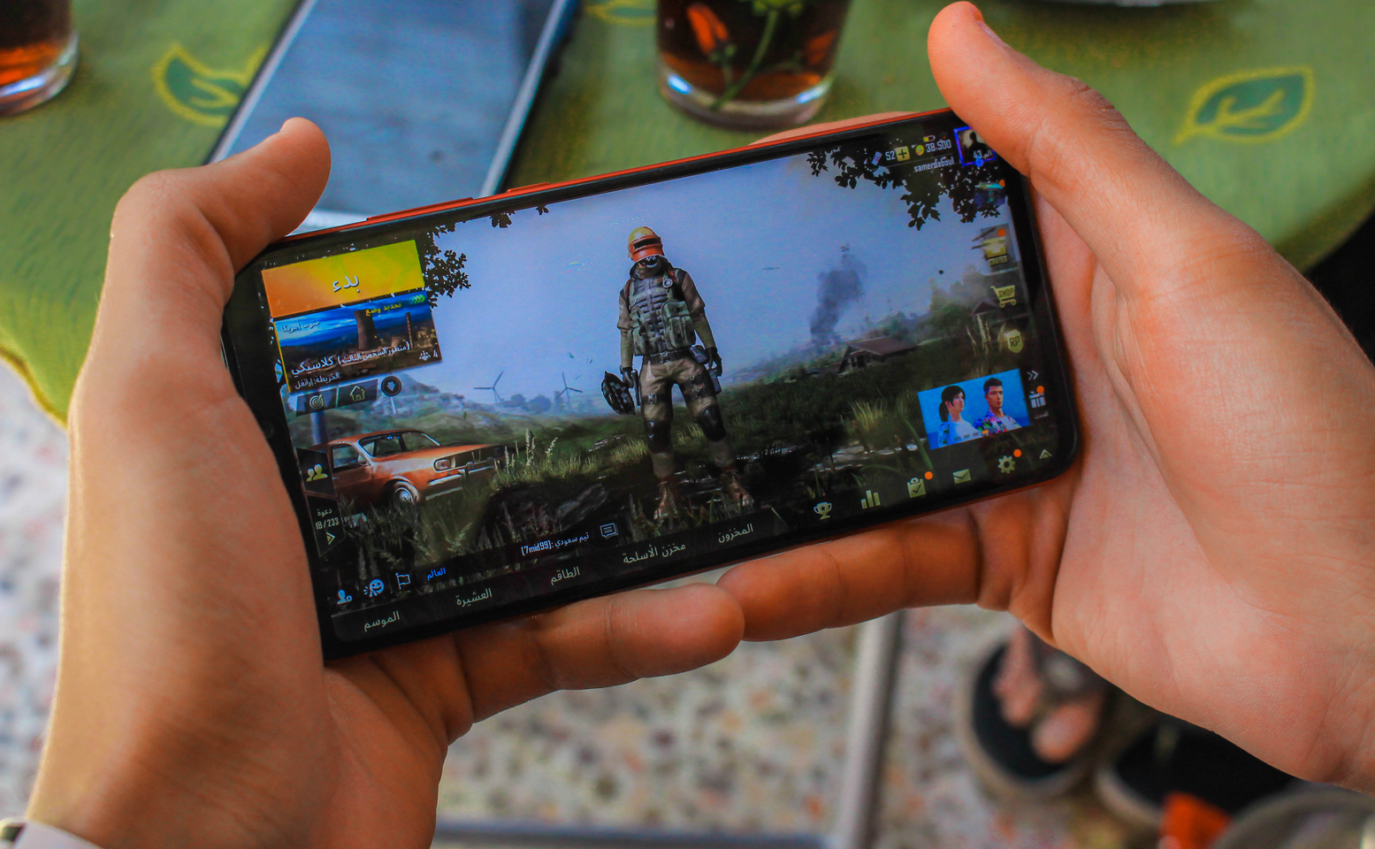



PLAYER PROFILING AND BEHAVIORAL ANALYSIS
AI algorithms collect and analyze how players move, fight, or explore.
Games like Fortnite or Call of Duty adjust difficulty levels or opponent strength based on performance.
This profiling keeps players challenged but not frustrated, maintaining long-term engagement.
AI allows each player to have a personalized experience, creating emotional satisfaction.

Slide 7
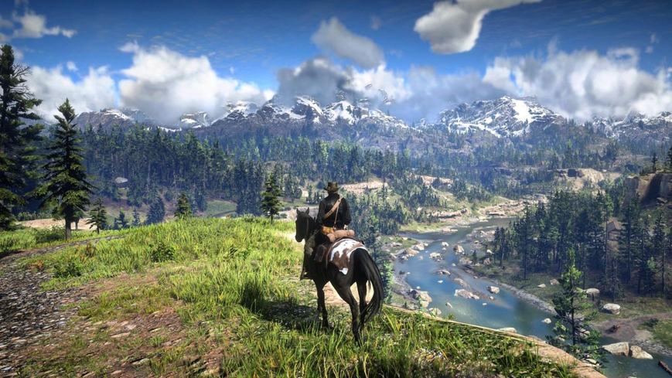
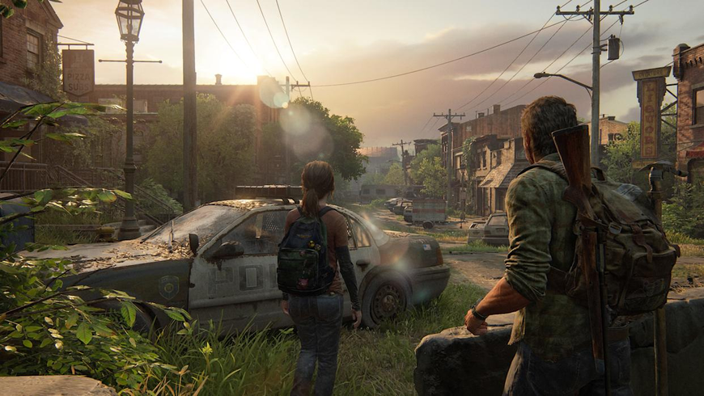
INTELLIGENT CHARACTER BEHAVIOR
AI is used to simulate real human-like reactions in Non-Player Characters (NPCs).
Through deep learning, NPCs can respond differently in every situation — showing fear, aggression, or curiosity.
Example: In The Last of Us, Red Dead Redemption, enemies react intelligently to stealth and sound.
Such emotional realism improves player immersion and connection with the story.

Slide 8
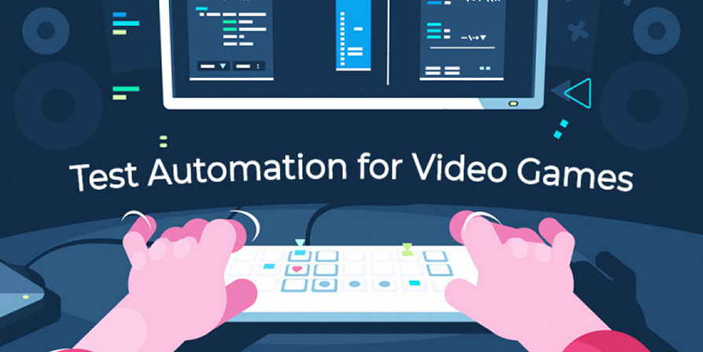

AUTOMATION AND GAME PRODUCTION
Game studios now use AI automation to design levels, textures, and even storylines.
Algorithms can generate procedural environments, meaning the world changes every time you play.
This reduces manual coding work and boosts creativity.
Developers use AI tools like TensorFlow and Unity ML-Agents for dynamic content creation.

Slide 9
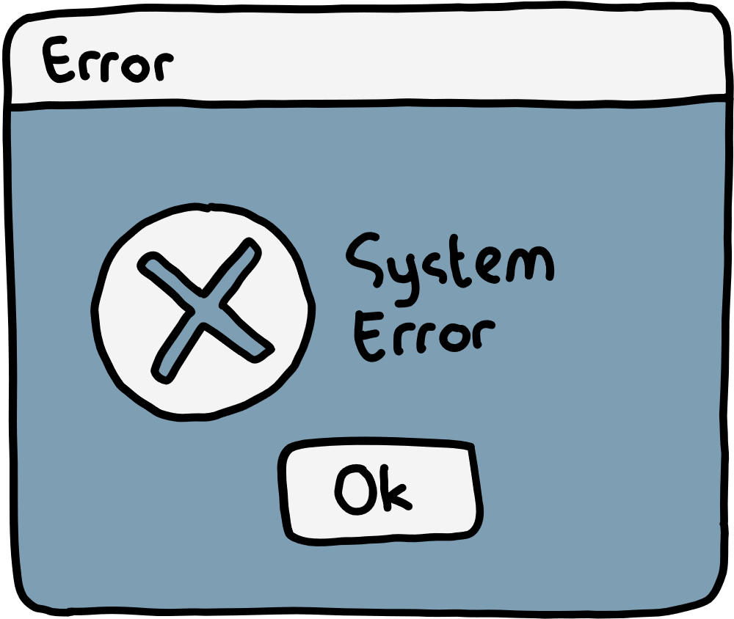

LIMITATIONS OF AI IN GAME DEVELOPMENT
High development cost and computing power
Limited creativity — AI lacks emotional depth
Risk of repetitive or predictable behaviour
Ethical issues: player data privacy and manipulation
Simulation errors and AI can visualize our world

Slide 10



AI: THE NEW GAME DEVELOPER
AI allows developers to create smarter, more adaptive, and deeply personalized games
It’s transforming games from fixed scripts into living, evolving ecosystems
AI helps the developer to code easily and quickly

Slide 11



FUELING A BILLION-DOLLAR INDUSTRY
The global gaming industry is projected to reach USD 315 billion by 2026, driven by AI.
Start-ups like Latitude raised $3.3 million for their AI-generated storylines.
This isn't just a tech shift; it's a massive business and creative revolution.

Slide 12


THE ETHICAL ARENA
With great power comes great responsibility
Data Privacy: How is your player profile being protected?
Fair Play: Is the AI manipulating your behaviour?
Addiction Control: Could AI be designed to exploit player psychology?

Slide 13



THE ROADBLOCKS AHEAD
We face significant challenges
Technical limits and hardware dependency.
Algorithmic bias from non-inclusive data.
The ultimate challenge: balancing automation with the essential "human touch" in creativity.
THE FINAL LEVEL
AI will soon be a standard requirement for all game development.
This integration is not just about efficiency—it's about unlocking new forms of creativity, realism, and emotional connection.

Slide 14




CONCLUSION:
THE FUTURE WITH AI
AI is a core driving force, not just a tool
Enables continuous innovation in gaming
Extends game lifespans through adaptability
Creates deeply personalized player experiences
Fundamental to the future of game development

Slide 15



THANK YOU!
ANY QUESTIONS?
BYE!

